Slide 1
eProject Java Flortist
T1.2203.E1 Group 3

Slide 2
I. INTRODUCTION
One way of communicating wishes are by sending flowers. So our client “java florist” wants to develop a website which would help people to communicate wishes by sending flower bouquet on special occasion. Java Florist offers professionally designed flower arrangements for all occasions like Birthday, wedding, new baby, thank you, fathers day, mothers day etc. The services that will be offered by java florist include delivery of bouquets in Mumbai and surrounding areas, and can even handle flower delivery nationwide through there network of trusted florists

Slide 3
II. REQUIREMENT
The application will have a web page which have links or option home, My account, about flowers, view cart, ,florist registration etc.
the home page will also have link for different occasions and when the user clicks on any occasion the bouquets available with that occasion would be displayed with there price.
If the user wants to book any bouquets he has to register himself. At a time the user can book more than one bouquets. At the time of booking the bouquets gets attached to cart and the total price will be calculated.
The price would be paid through credit card.
After paying the money it should also collect the information to whom the bouquet have to be delivered, their name, address, phone no and the message.
For messages there would be dropdown list having all the occasion in the list. According to the selected occasion predefined messages will be displayed and the user can choose one of them. Also he can write his own message in the text area provided.
The bouquet will be delivered with in the five hour of the booking. The working hour of the florist is morning 9 a.m to evening 9 p.m. If the booking order is within the five hours of working hour the bouquet will be delivered on the same day otherwise it will be delivered on the next day.
Admin login should able to update and delete the bouquets available, there price etc.

Slide 4
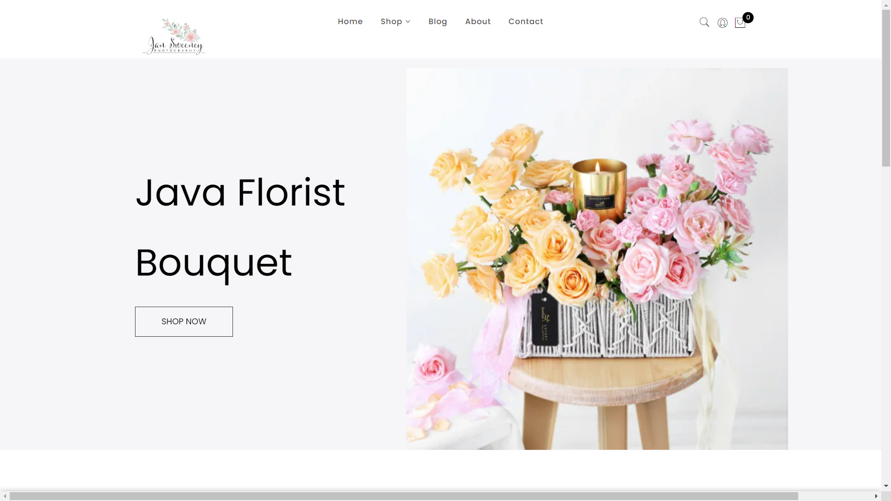
III. Home Page

Slide 5
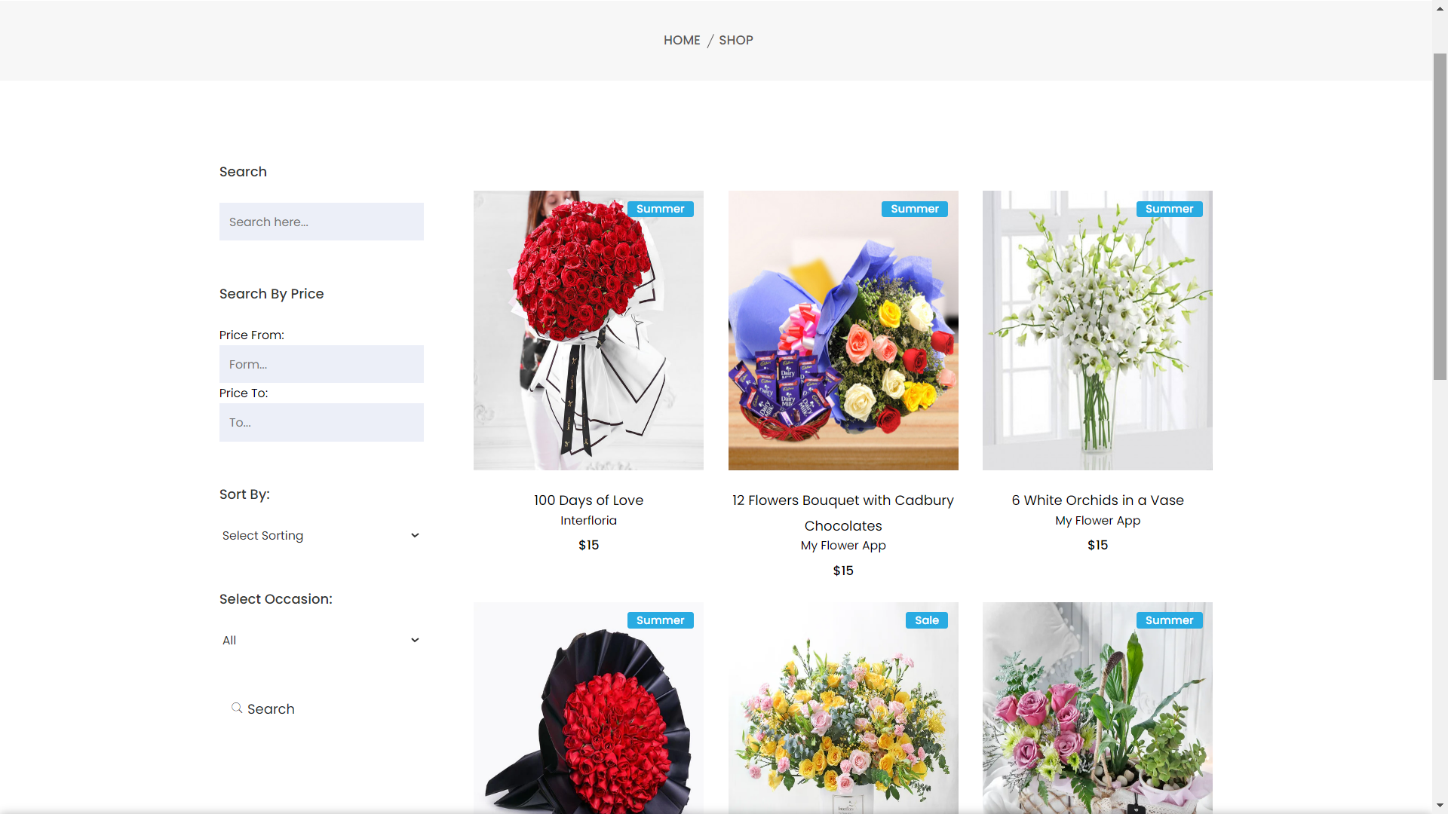
IV. Shop Page

Slide 6
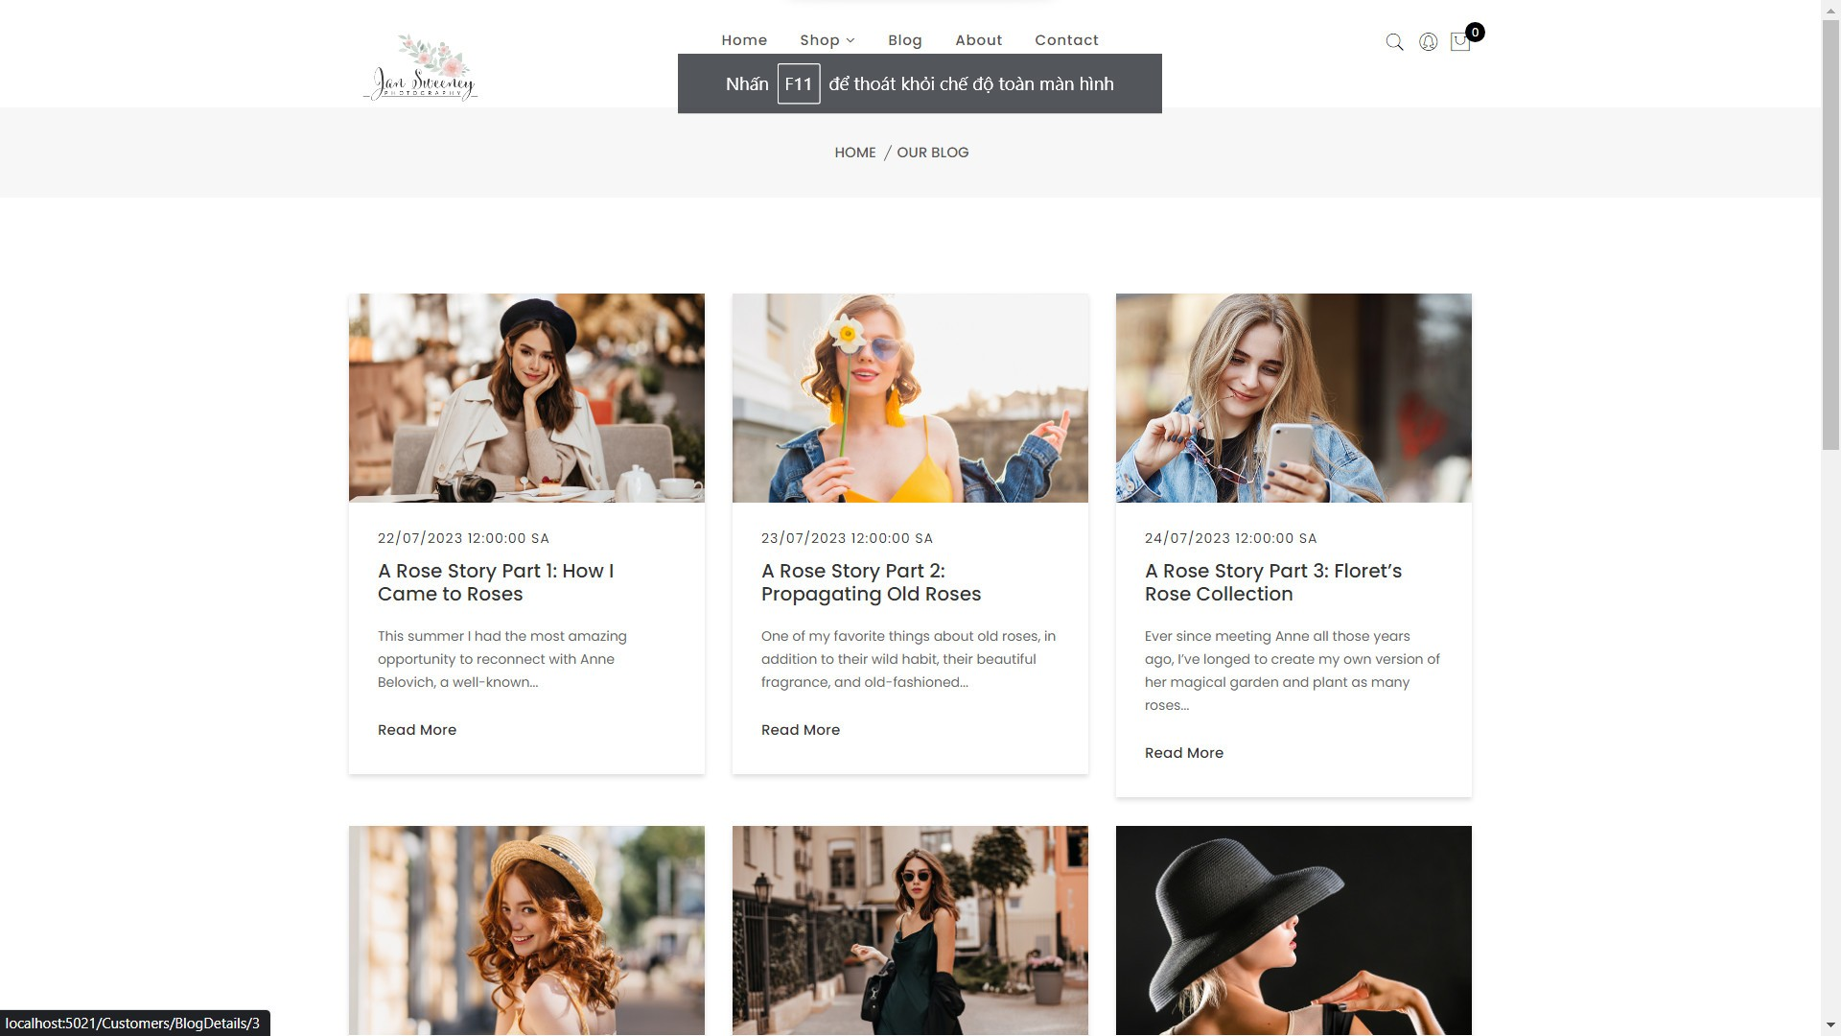
V. Blog

Slide 7
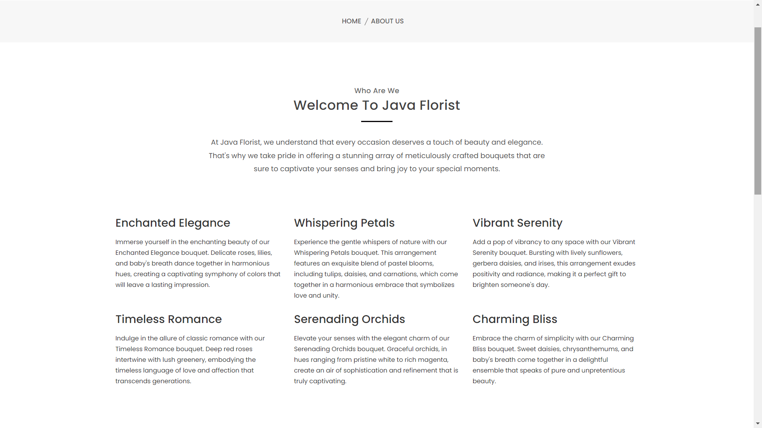
VI. About

Slide 8
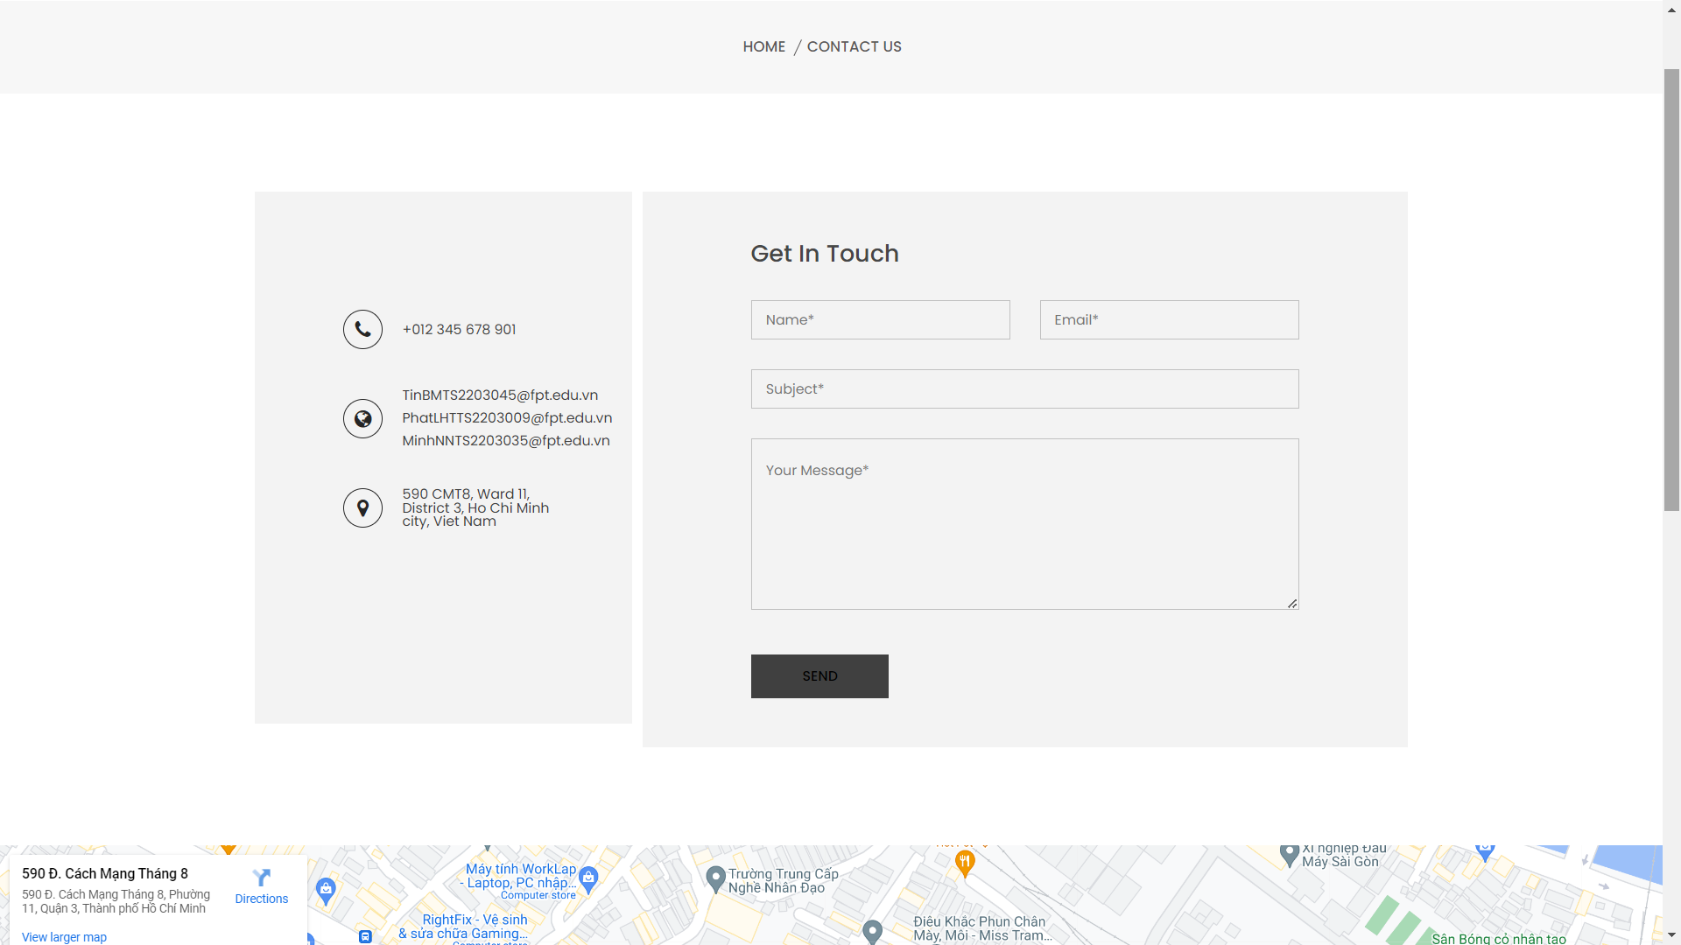
VII. Contact

Slide 9
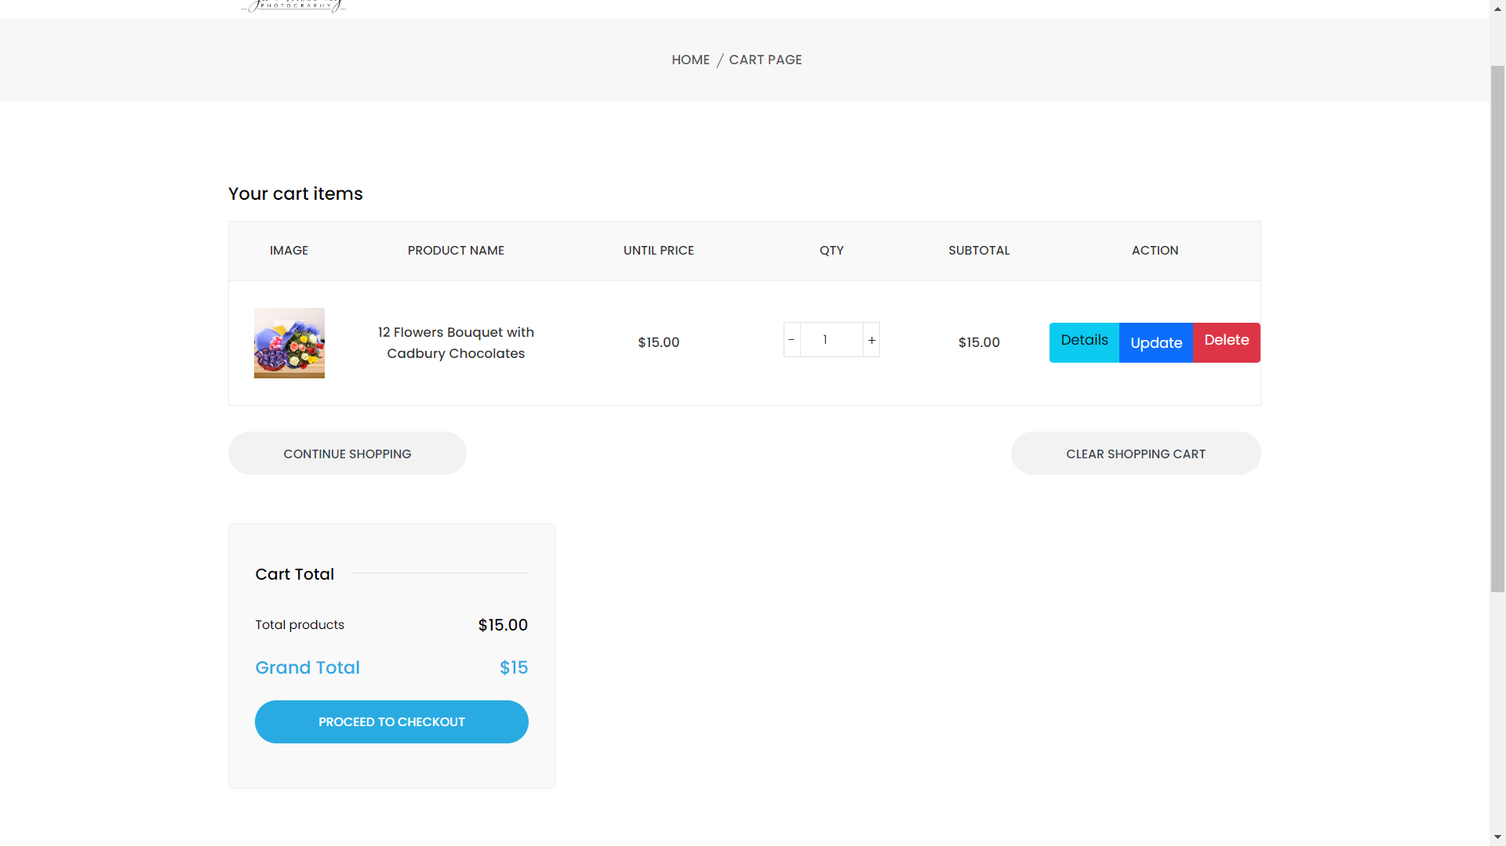
VII. Cart

Slide 10
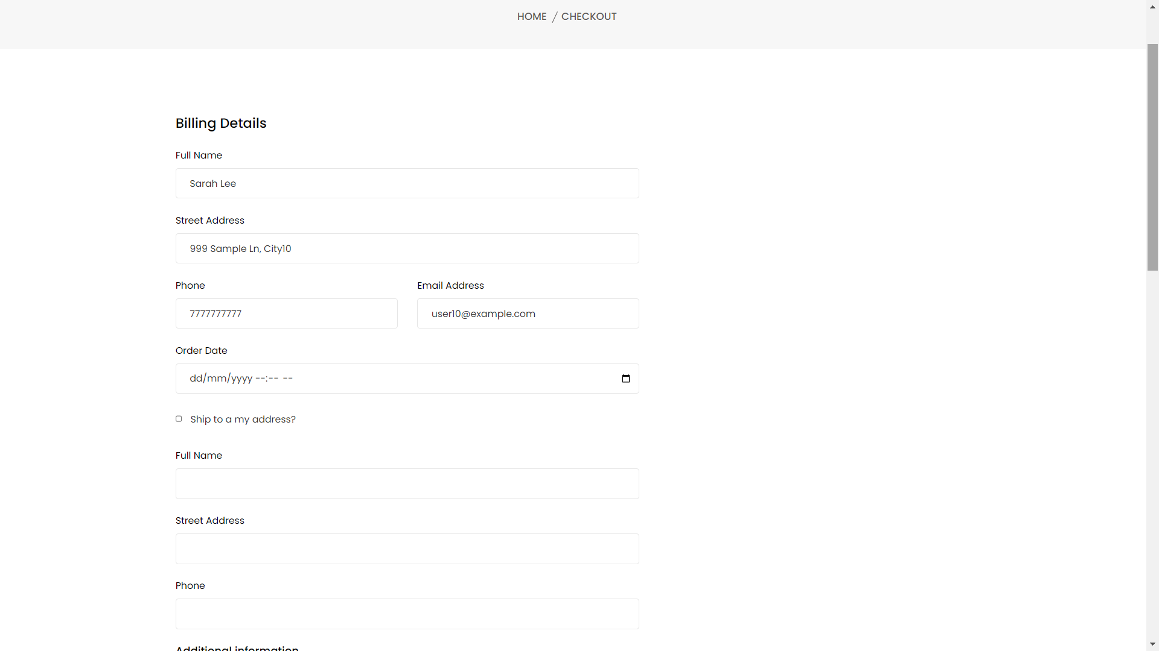
VIII. Check Out

Slide 11
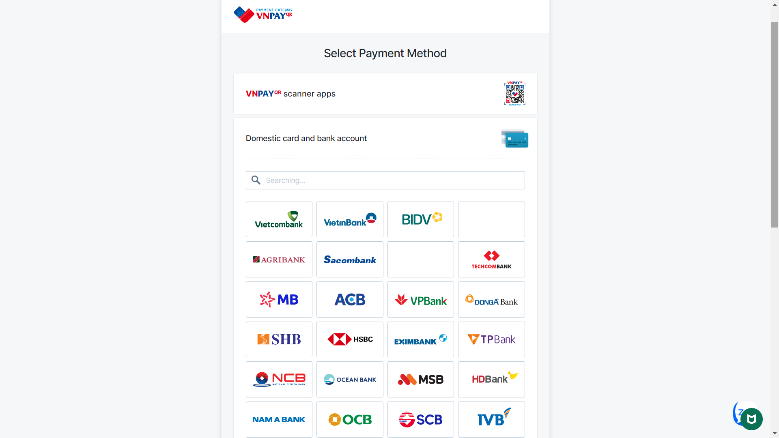
IX. Payment

Slide 12
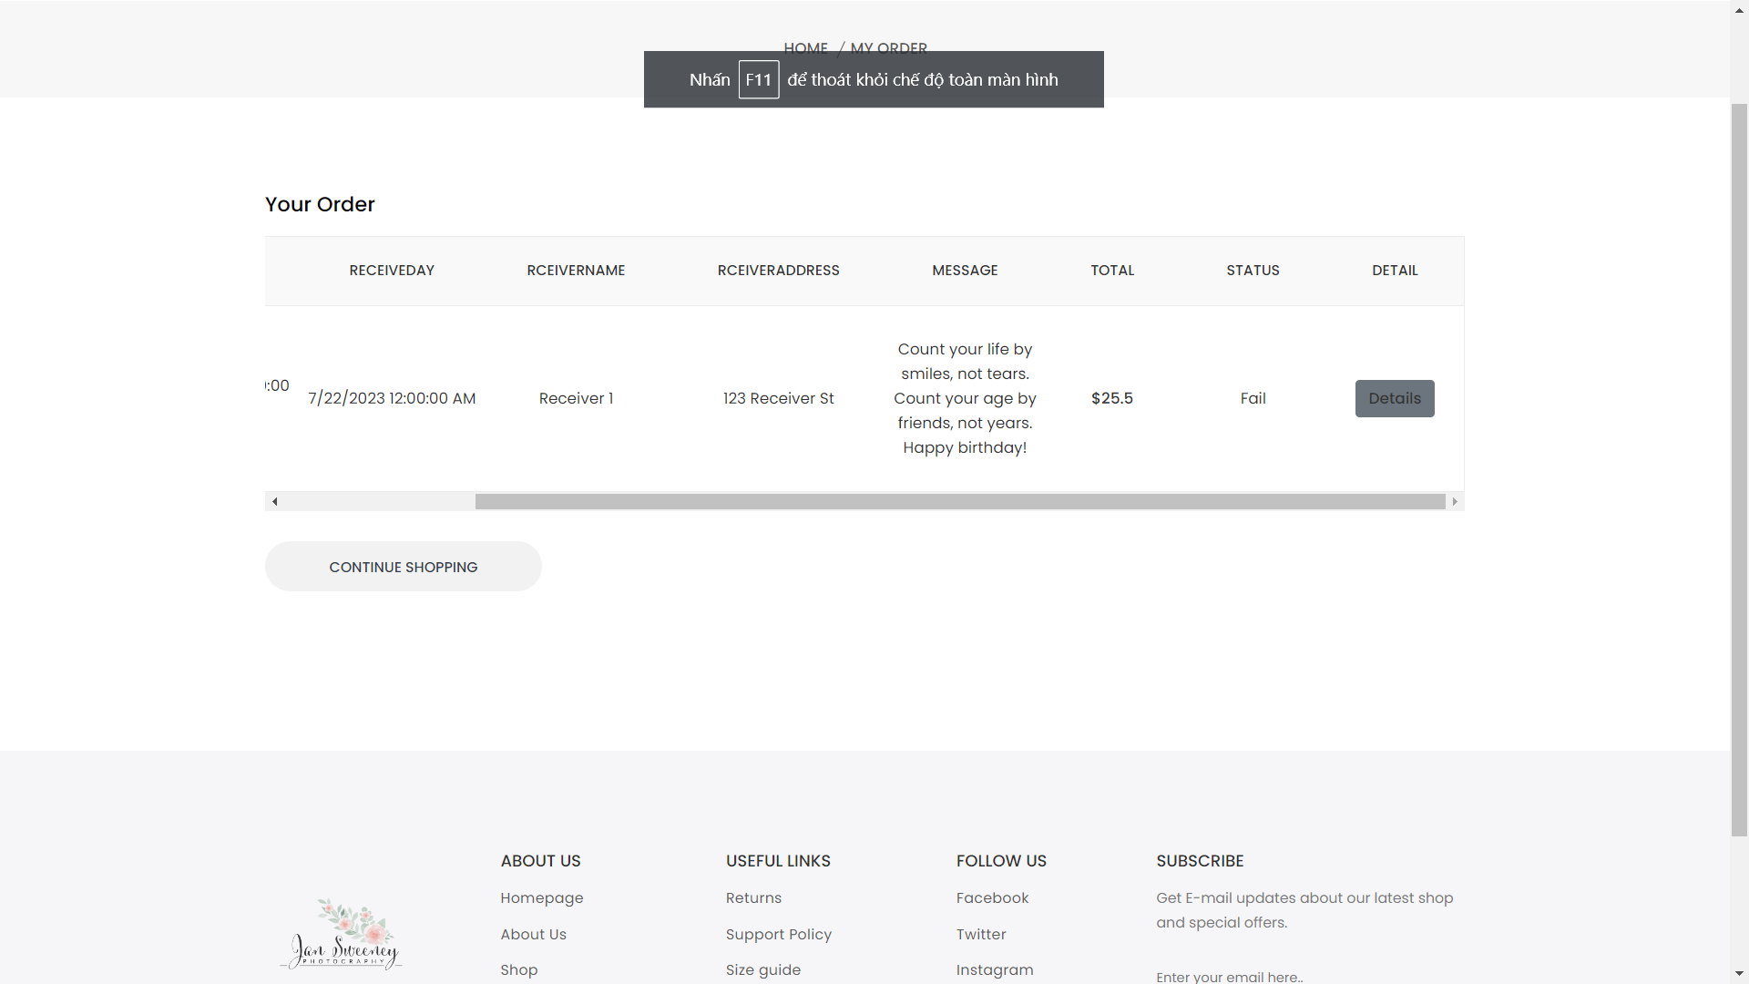
X. My Order

Slide 13
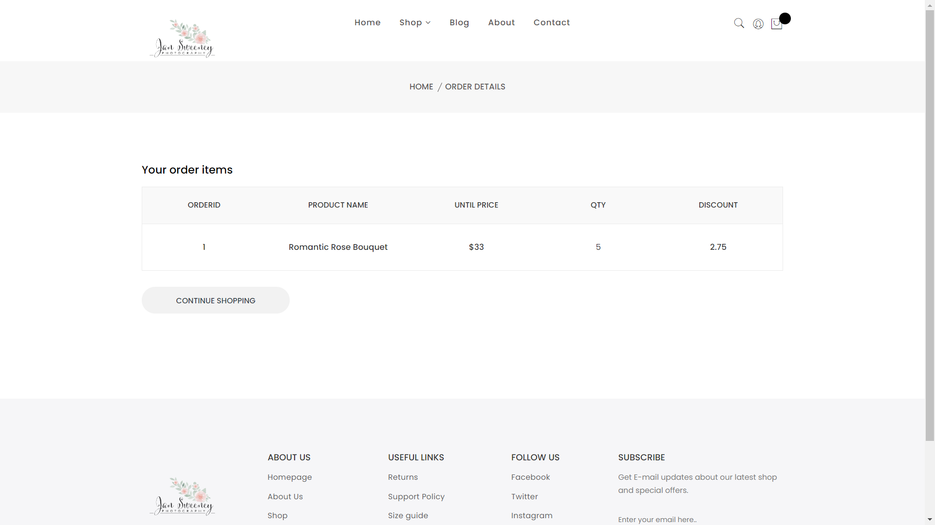
XI. Order Details

Slide 14
XII. Admin

Slide 15
XIII. Florist

